Slide 1
Murach’s PHP and MySQL (4th Edition)
Chapter 6
How to test and debug a PHP application

Slide 2
Objectives
Applied
Test and debug your PHP applications.
Trace the execution of a PHP application with echo statements.
If you’re using an IDE like NetBeans, set breakpoints, step through code, observe the changes in variables, and use the stack trace.
Knowledge
Distinguish between testing and debugging.
Distinguish between syntax, runtime, and logic errors.
Describe the use of breakpoints and stepping through code when you’re using an IDE like NetBeans for debugging.

Slide 3
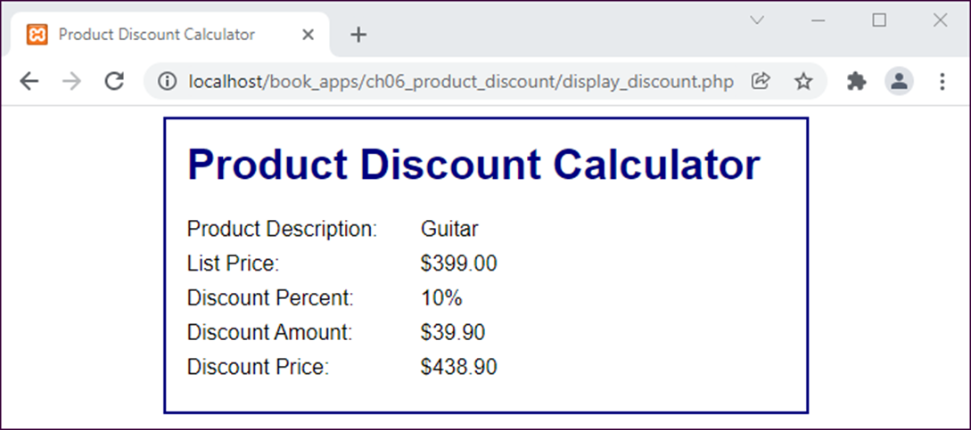
The Product Discount app with a logic error

Slide 4
The goal of testing
To find all errors before the application is put into production.
The goal of debugging
To fix all errors before the application is put into production.
Three test phases
Check the user interface to make sure that it works correctly.
Test the application with valid input data to make sure the results are correct.
Test the application with invalid data or unexpected user actions. Try to make the application fail.

Slide 5
The three types of errors that can occur
syntax errors
runtime errors
logic errors

Slide 6
PHP code that contains errors
// validate the list price entry
if ( $list_price = NULL || $list_price = FALSE ) {
$error = "Please enter a valid number.';
} else {
$error = ''
}

Slide 7
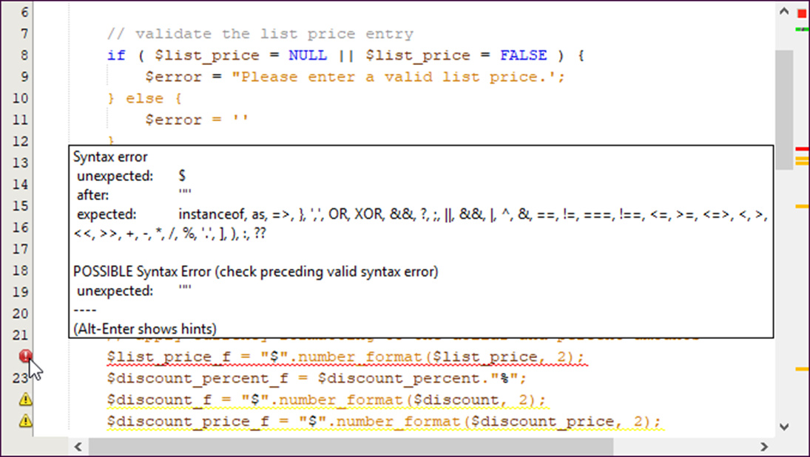
The PHP code that contains errors in NetBeans

Slide 8
Common syntax errors
Misspelling keywords.
Forgetting an opening or closing parenthesis, bracket, brace, or comment character.
Forgetting to end a PHP statement with a semicolon.
Forgetting an opening or closing quotation mark.
Not using the same opening and closing quotation mark.

Slide 9
Problems with variable names
Misspelling or incorrectly capitalizing a variable name.
Using a keyword as a variable name.
Problems with values
Not checking that a value is the right data type before processing it.
Using one equals sign instead of two when testing for equality.

Slide 10
PHP with echo statements that trace the execution of the code
// calculate the future value
$future_value = $investment;
echo '$future_value: ' . $future_value . '<br>';
echo '$interest_rate: ' . $interest_rate . '<br>';
echo '$years: ' . $years . '<br>';
echo 'For loop for calculating future value is starting...<br><br>';
for ($i = 1; $i <= $years; $i++) {
$future_value += $future_value * $interest_rate;
echo '$i: ' . $i . '<br>';
echo '$future_value: ' . $future_value . '<br>';
}

Slide 11
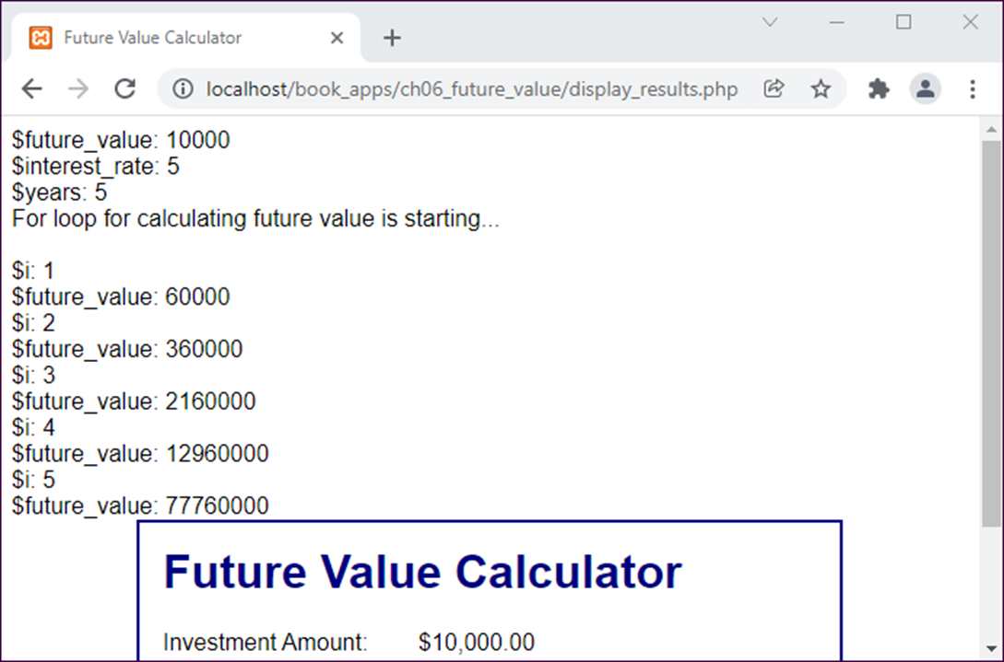
The data displayed in a browser

Slide 12
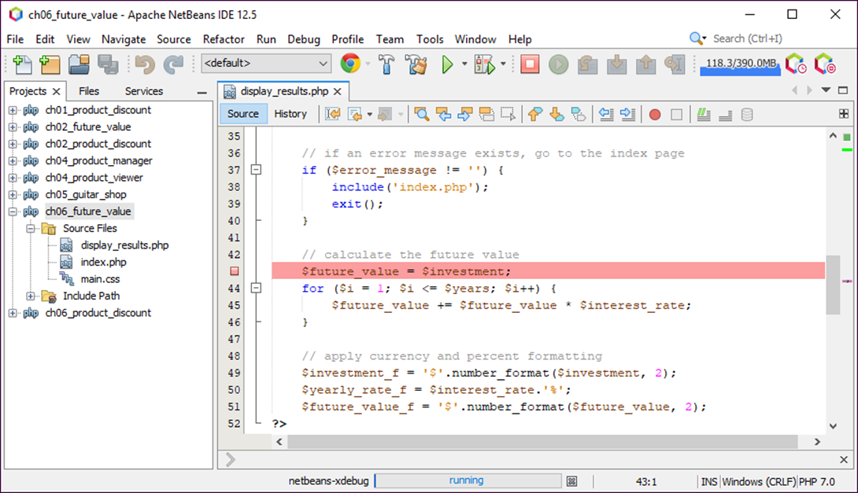
A code editor window with a breakpoint

Slide 13
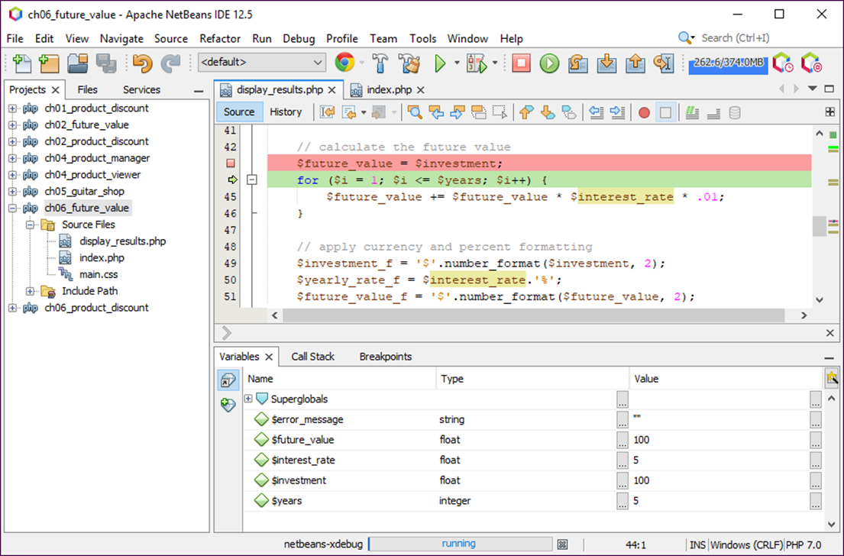
A debugging session with variables displayed

Slide 14
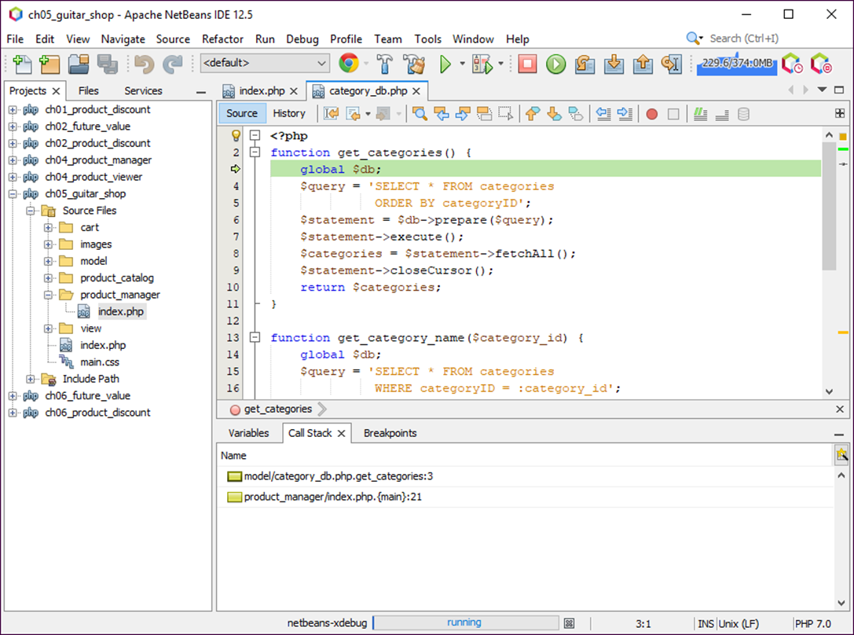
A debugging session with a stack trace displayed

